Slide 1
Student Placement Analysis
Submitted By:
Name: Shani Raj
Roll no.: 1323583
Class: BCA (DS2)
25 July 2025
Submitted To:
Himanshu Shardna
Xplore Trainer

Slide 2

Why?
Student Placement
Analysis

Slide 3
Know the Data
To analyze anything we need to know about the data

Slide 4
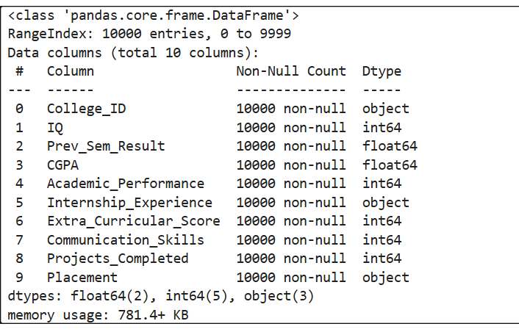
Data info

Slide 5
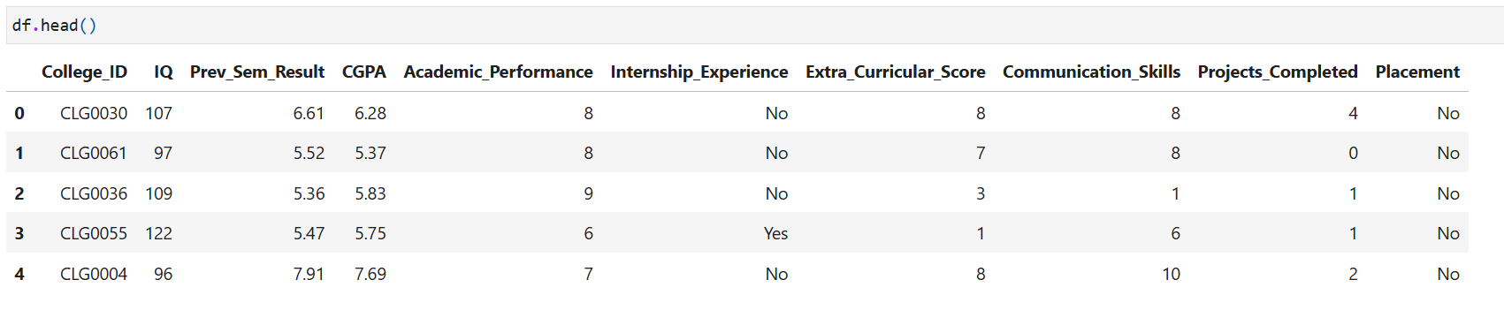
Data Heads

Slide 6
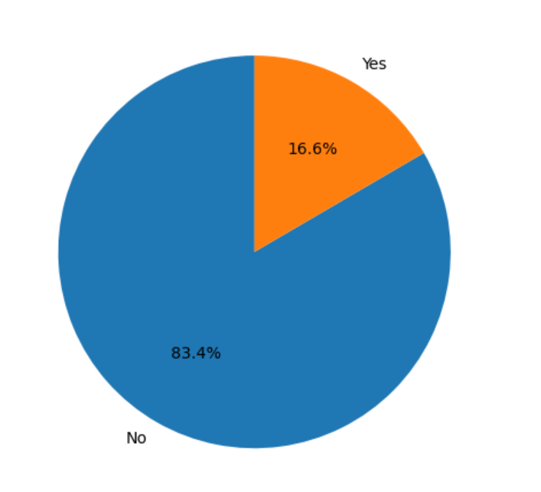
Placement Status

Slide 7
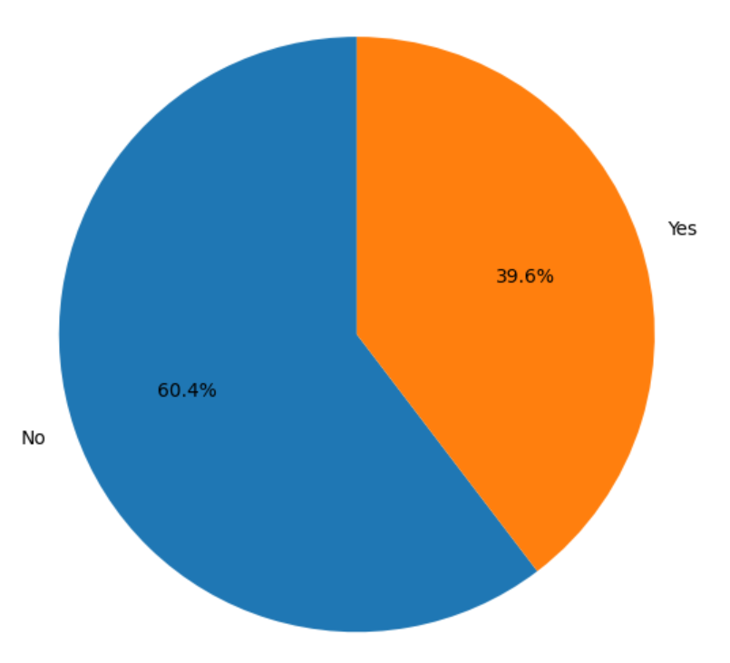
Internship Exprience

Slide 8
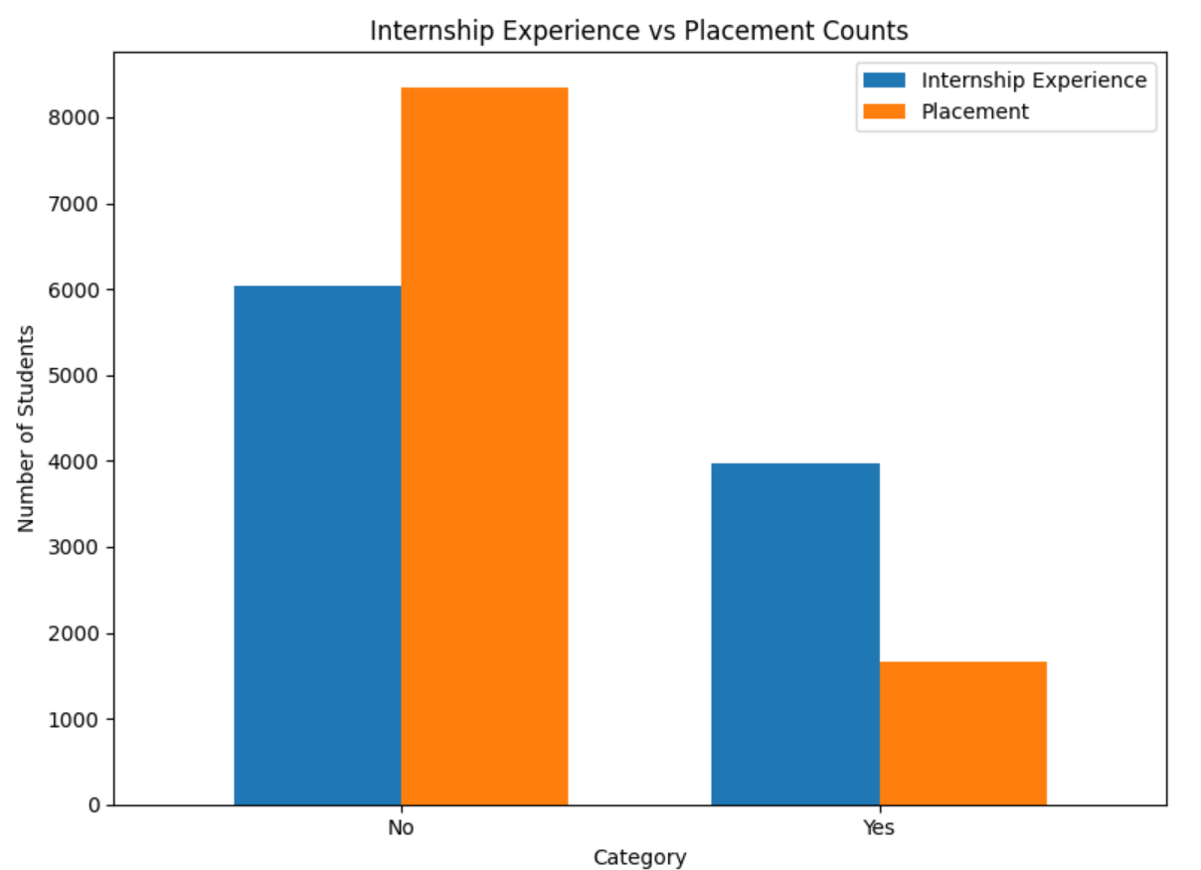
Internship vs Placement

Slide 9
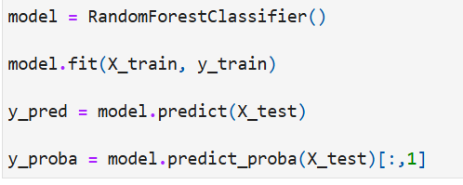
Model Implementation

Slide 10
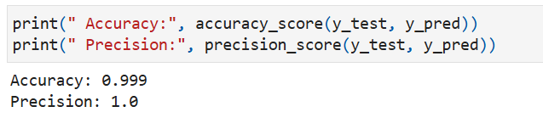
Model Accuracy

Slide 11
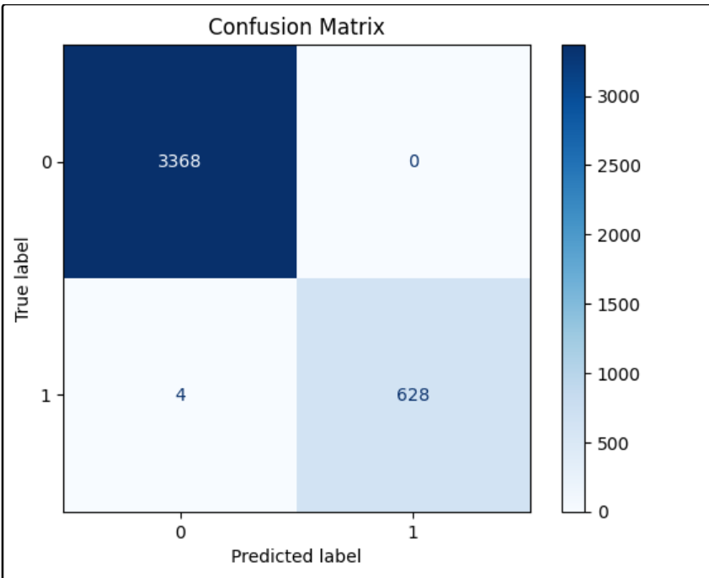
Confusion Matrix

Slide 12
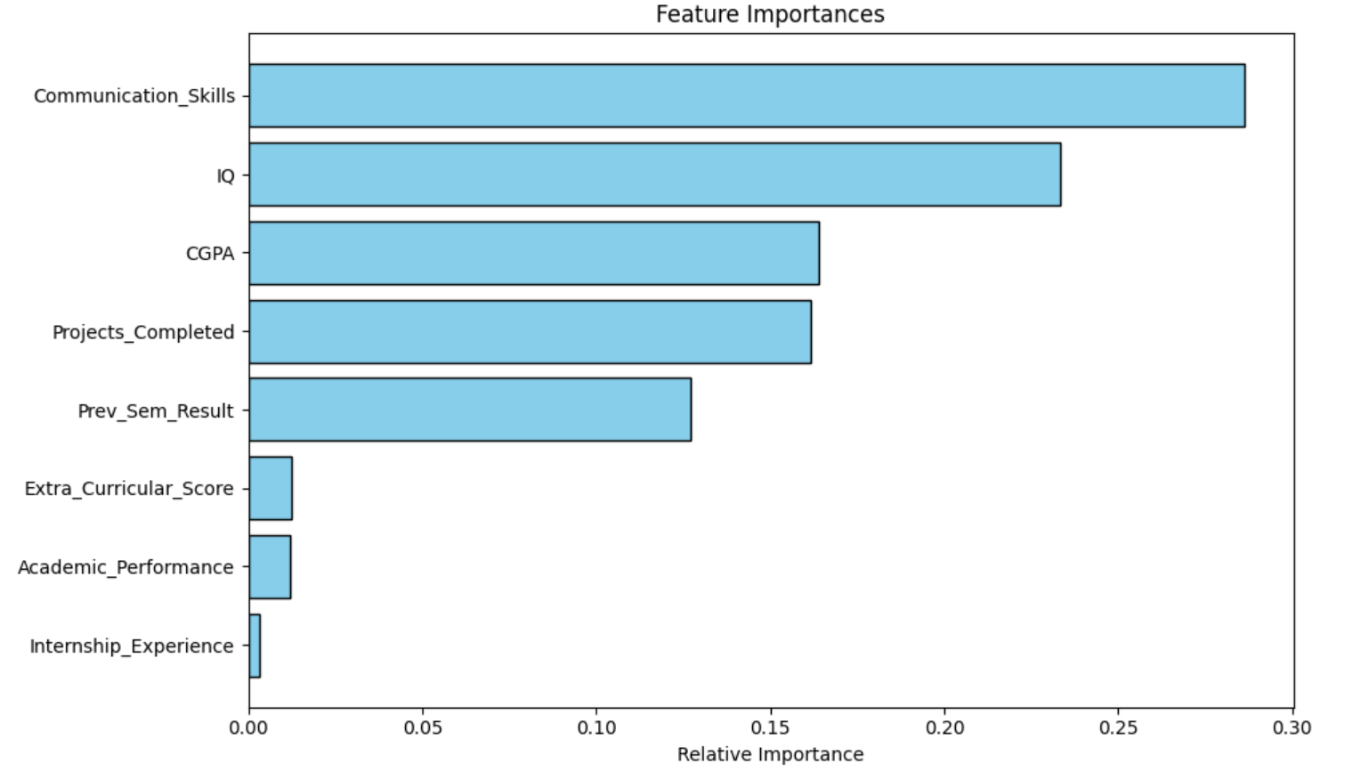
Feature Importance

Slide 13
Library Required
import pandas as pd
import seaborn as sns
import numpy as np
import matplotlib.pyplot as plt
from sklearn.model_selection import train_test_split
from sklearn.preprocessing import StandardScaler
from sklearn.ensemble import RandomForestClassifier

Slide 14
Resources
Kagal.com
Google.com
Here is the Code
Click Here

Slide 15
Thank You

